Slide 1

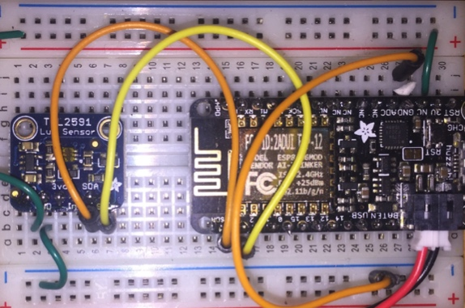
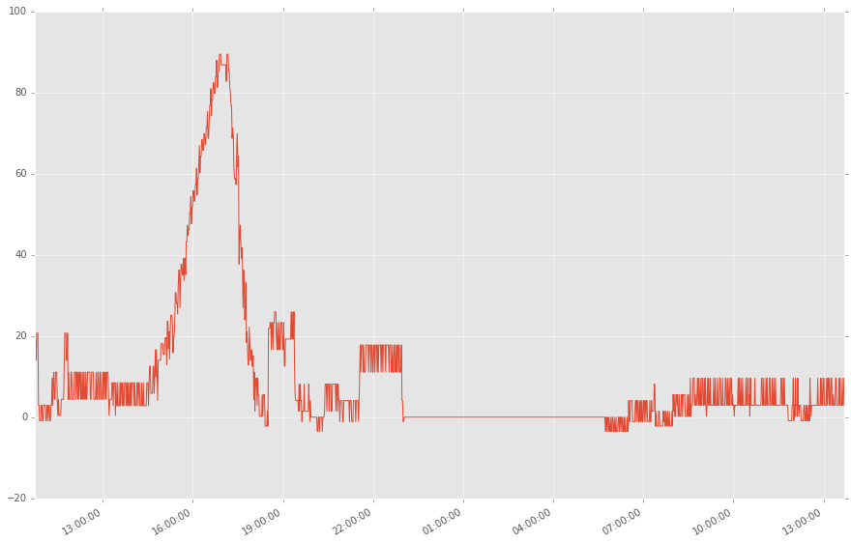
MicroPython IoT Hackathon
Featuring the ESP8266
Jeff Fischer
Daniel Mizyrycki
Robert Queenin
PyBay Conference August 2017

Slide 2
Today’s Agenda
Part 1:
Overview lecture
Build and test light sensor system (hardware and software)
Part 2:
Break into teams
Brainstorm on projects
Build projects
Demos!

Slide 3
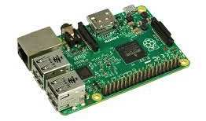
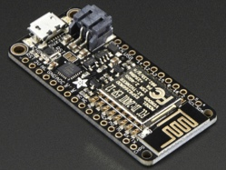

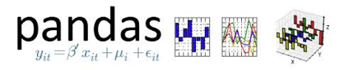


Why Python for IoT?
High-level, easy to prototype ideas and explore options
Runs on embedded devices
Python data analysis ecosystem
Array and matrix processing
High level data analysis tools
Numerical analysis routines
HMMLearn
Machine learning

Slide 4
Basic Electronics
Current
Voltage = Electrical Pressure
Current = Flow of electric charge
Resistance = Difficulty to pass
electric charge
Electrons
+ (Vcc)
Circuit
Power
Supply
Ohm’s Law
V = I R
- (GND)
resistance
voltage
current

Slide 5
Digital Logic
Voltage
Vcc (5V or 3.3V)
High (“1”)
Noise Margin
Low (“0”)
GND (0V)

Slide 6

Cautions
Do not connect power and ground directly to each other (“shorting”)
Chips are sensitive to static discharge, be careful
You might touch some metal (e.g. your laptop chassis before handling the electronics)

Slide 7
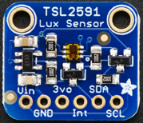
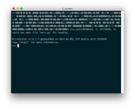
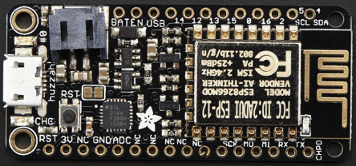
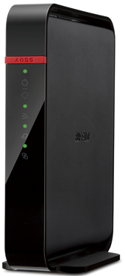
Light Sensor System Overview
TSL2591 Lux Sensor
breakout board
PC/Laptop
USB Cable
MQTT
Broker
I2C Bus
Terminal
session
ESP8266 breakout board
MQTT over WiFi
WiFi Access Point
and Router

Slide 8
Steps
Hardware Assembly
Firmware and software install
Application to read the sensor
Messaging with MQTT

Slide 9
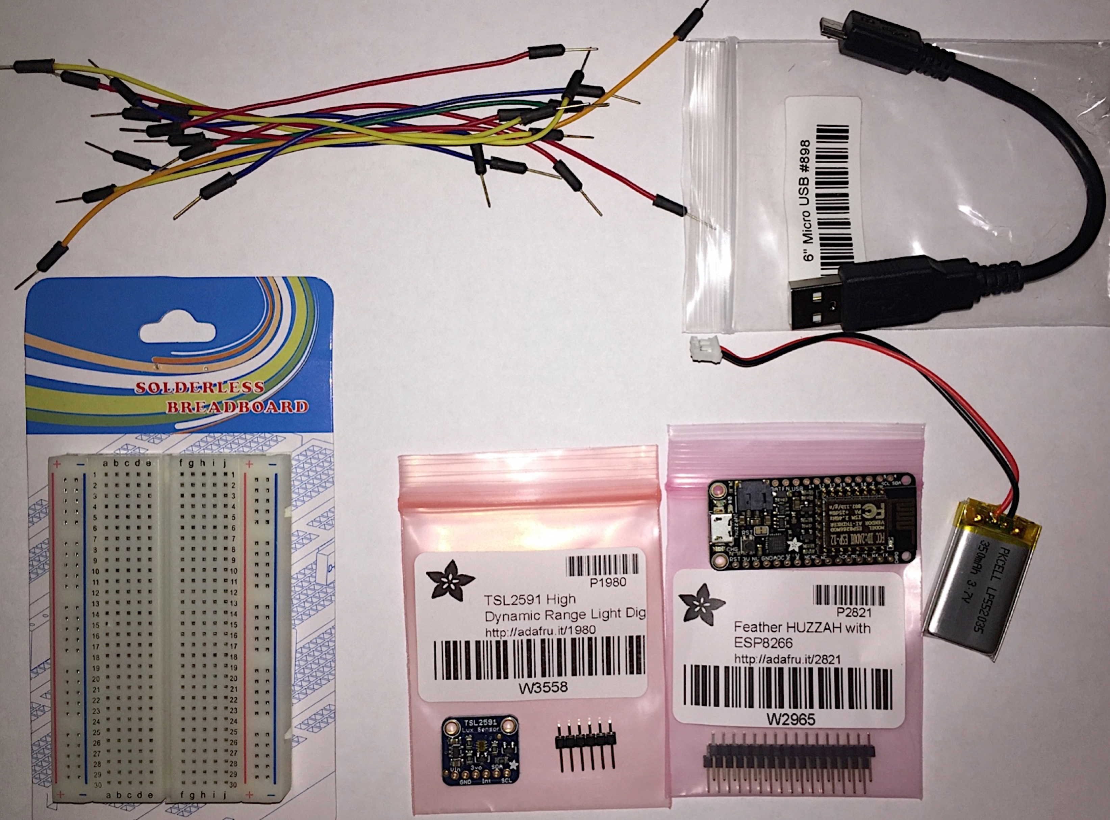
Parts
Wires
USB Cable
ESP8266
Breakout
TSL2591
Breakout
Battery
Breadboard

Slide 10
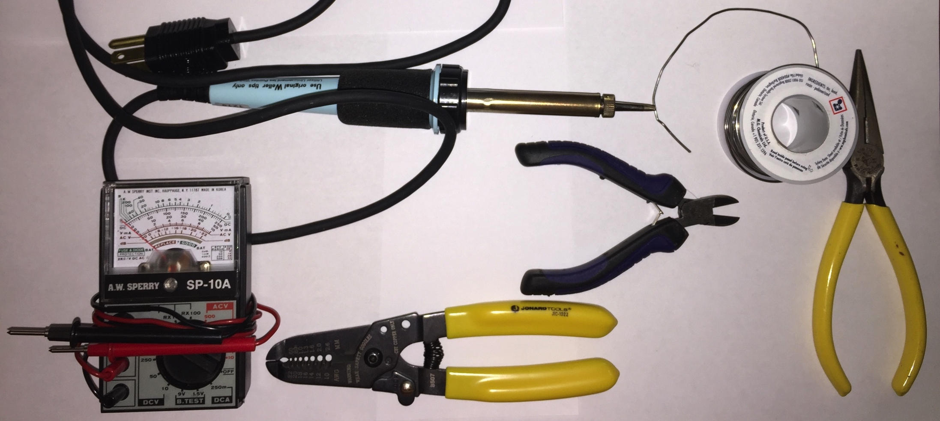
Recommended Tools
Soldering Iron
Solder
Multimeter
Wire Cutters
Wire Strippers
Needle-nose
Pliers

Slide 11
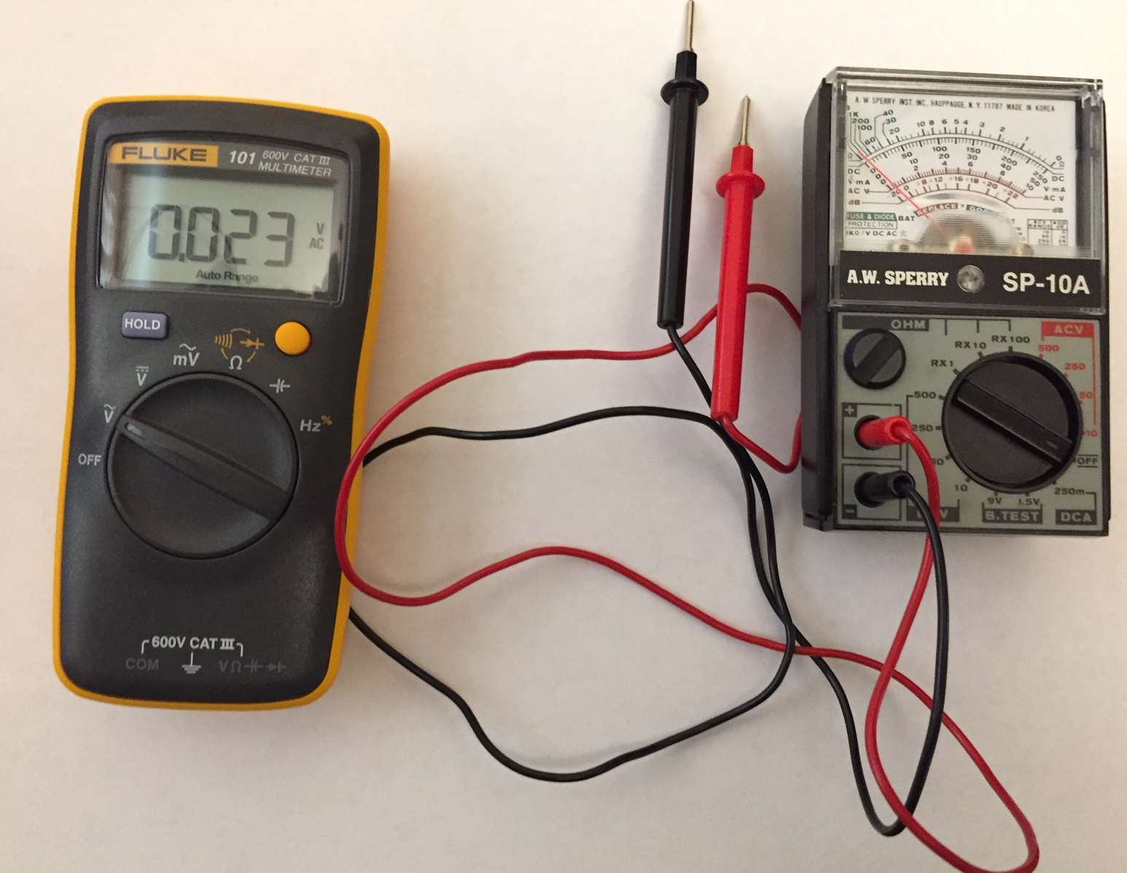
Multi-testers
Measures Volts, Amps, and Ohms (resistance)
Digital and analog flavors
Analog may require manually setting the range
Use resistance to check continuity:
0 Ohms = Connection

Slide 12
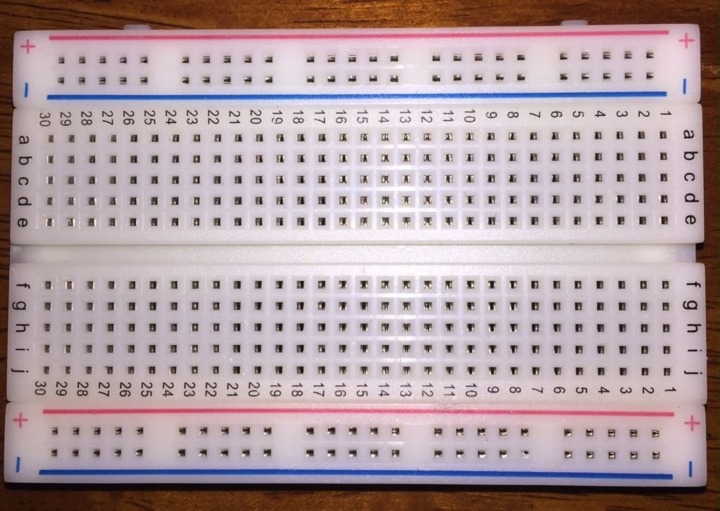
Breadboards
Use for Power
Photo
Electrical Connections
30
29
2
1
a
b
c
d
e
. . .
Board
f
g
h
i
j
Use for pin connections
Use for GND

Slide 13
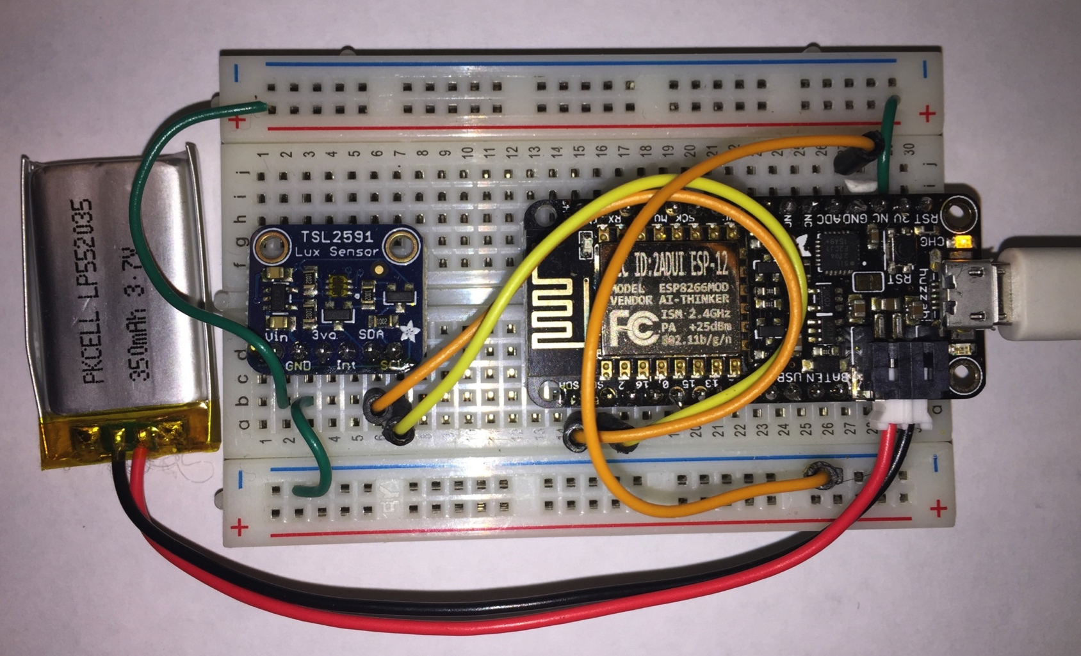
System with Adafruit Feather HUZZAH
½ Size breadboard
Lithium Ion
Polymer
Battery
3.7v 350mAh
MicroUSB to
USB cable
Adafruit Feather HUZZAH
ESP8266 breakout board
TSL2591
lux sensor
breakout
board
Notes:
8266:
32-bit RISC CPU: Tensilica Xtensa LX106 running at 80 MHz
64 KiB of instruction RAM, 96 KiB of data RAM
Power: 15 mA if modem off, 50 – 170 mA when transmitting (http://bbs.espressif.com/viewtopic.php?t=133)

Slide 14
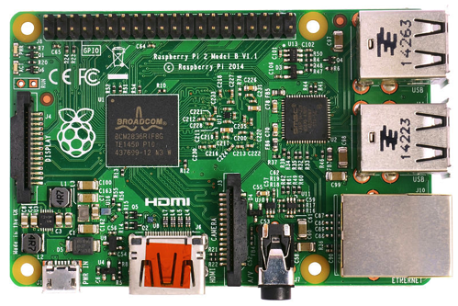
Today’s MQTT Setup
TSL2591 Lux Sensor
breakout board
Participant
Laptop
Instructor
Laptop
USB Cable
I2C Bus
MicroPython
REPL
mosquitto_sub
SSH login to Pi
ESP8266 breakout board
MQTT
Broker
MQTT over WiFi
Raspberry Pi
WiFi Access Point
and Router

Slide 15
Zip Directory Tree Structure
micropython-iot-software/
docs/
micropython-iot-hackathon/
micropython/
thingflow-python/
drivers/ (for MacOS and Windows)
esp8266-20170612-v1.9.1.bin (Firmware image)
example_code/ (from hackathon repository)
micropython/ (ThingFlow and other code for ESP8266)
python-tools/ (Python libraries for your laptop)
terminal/ (PuTTY for Windows, screen for Linux)
thingflow-python/ (repo with source and example code)

Slide 16
Next Steps
Follow the detailed instructions in the HTML documentation, starting with “Hardware Assembly”
For software install, use either the shorter version (chapter 9 for Linux and Mac only) or the longer version (chapter 4)
You can skip the section on the MQTT broker – you can connect to my Raspberry Pi
If you get done early, take a look at the extra projects section
Feel free to ask for help!

Slide 17
Thank You
Questions?
More information
Email: jeff@data-ken.org
Hackathon Tutorial: http://micropython-iot-hackathon.readthedocs.io/en/latest/
Website and blog: https://data-ken.org
ThingFlow: https://github.com/mpi-sws-rse/thingflow-python

Slide 18
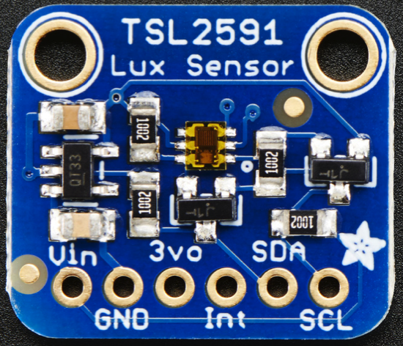
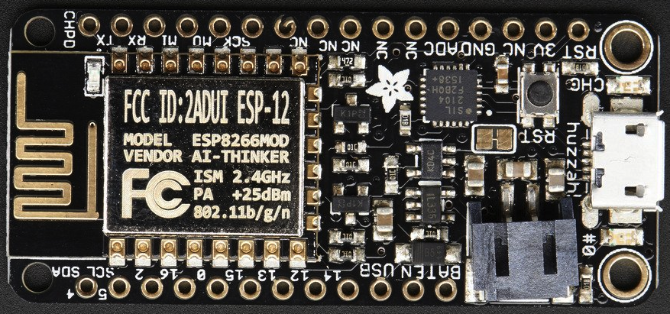
Feather HUZZAH: Wiring Diagram
3V Bus
GND Bus
A3
A1
A2
A5
A4
A6
SDA
SCL

Slide 19
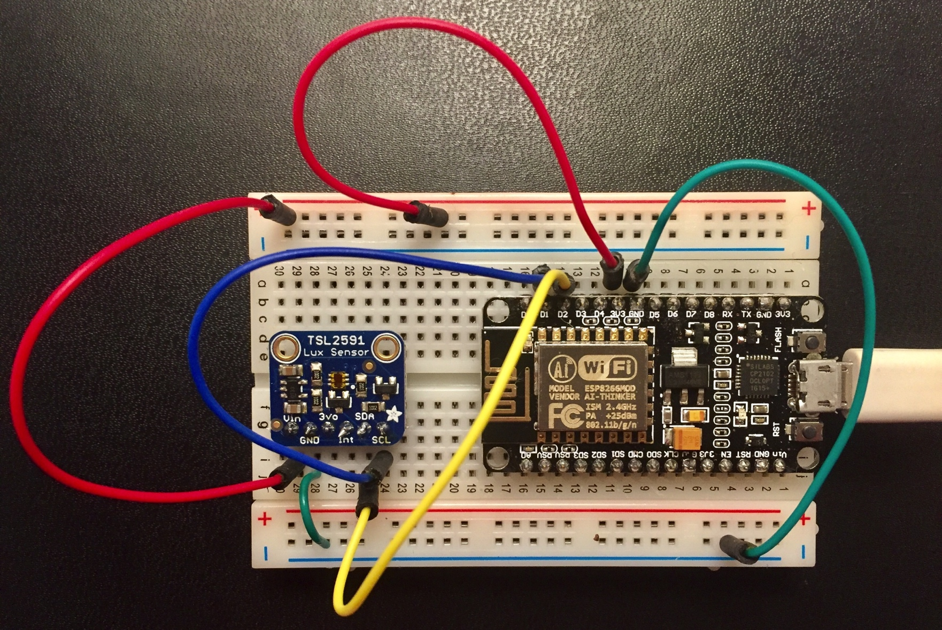
System with NodeMCU
NodeMCU
ESP8266
breakout board
MicroUSB to
USB cable
TSL2591
lux sensor
breakout
board

Slide 20
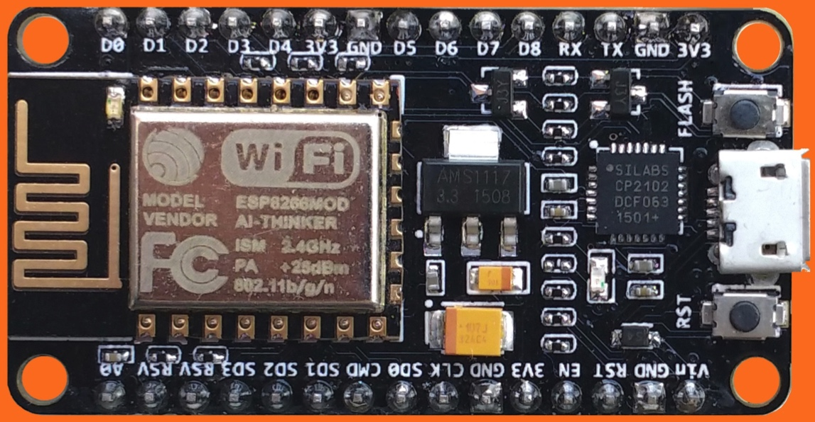
NodeMCU: Wiring Diagram
3V Bus
N3
N5
N1
SDA
SCL
N6
N4
N2
GND Bus

Slide 21
Reading the Light Sensor
from thingflow import *
from tsl2591 import Tsl2591
tsl = Tsl2591('lux-1')
sched = Scheduler()
sched.schedule_sensor(tsl, 2.0, Output())
sched.run_forever()
Lux
Sensor
Output
Invokes once every 2 seconds
Scheduler

Slide 22
MQTT
Client-A
Publish
Broker
Subscribe
Client-D
Client-B
Publish
Topic1
Subscribe
Client-E
Publish
Topic2
Subscribe
Client-C
Topic3
Client-F
. . .
Subscribe
Publish

Slide 23
Client.py: Send events to MQTT
Lux
Sensor
MQTT
Writer
Invokes once every SLEEP_TIME seconds
Scheduler

Slide 24
Client.py: Send events to MQTT
# Configuration is stored in a separate config.py
from config import SENSOR_ID, WIFI_ESSID, WIFI_PASSWORD, MQTT_HOST,\
MQTT_TOPIC, SLEEP_TIME
from wifi import wifi_connect, disable_wifi_ap
from thingflow import *
from tsl2591 import Tsl2591
from mqtt_writer import MQTTWriter
# setup network
disable_wifi_ap()
wifi_connect(WIFI_ESSID, WIFI_PASSWORD)
# create objects
m = MQTTWriter(SENSOR_ID, MQTT_HOST, 1883, MQTT_TOPIC)
tsl = Tsl2591(SENSOR_ID)
sched = Scheduler()
# schedule and run
sched.schedule_sensor(tsl, SLEEP_TIME, m)
print("Running main loop with sample every %s seconds..." % SLEEP_TIME)
sched.run_forever()

Slide 25
Server.py
MQTT
Adapter
Map
to
UTF8
Parse
JSON
Overwrite
timestamp
Write to
CSV
file
mqtt.select(lambda m:(m.payload).decode('utf-8'))\
.from_json(constructor=SensorEvent)\
.select(lambda evt: SensorEvent(sensor_id=evt.sensor_id,
ts=time.time(),
val=evt.val))\
.csv_writer(filename)

Slide 26
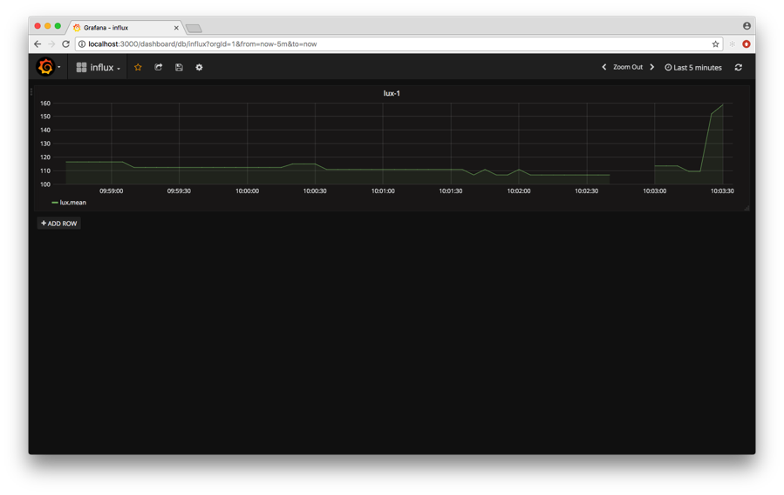
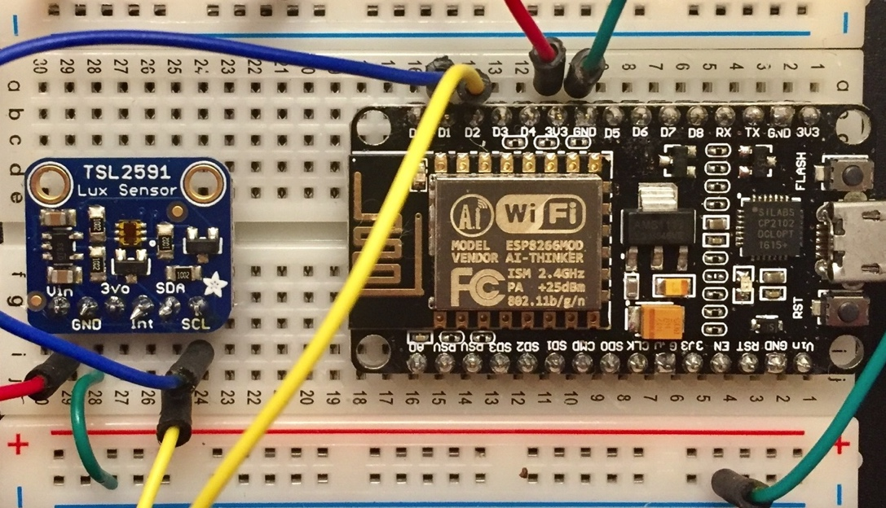
Using Grafana and Influxdb for a Real-time Dashboard
Sensor Systems
Grafana
MQTT
Broker
ThingFlow
Script
Influxdb

